Slide 1
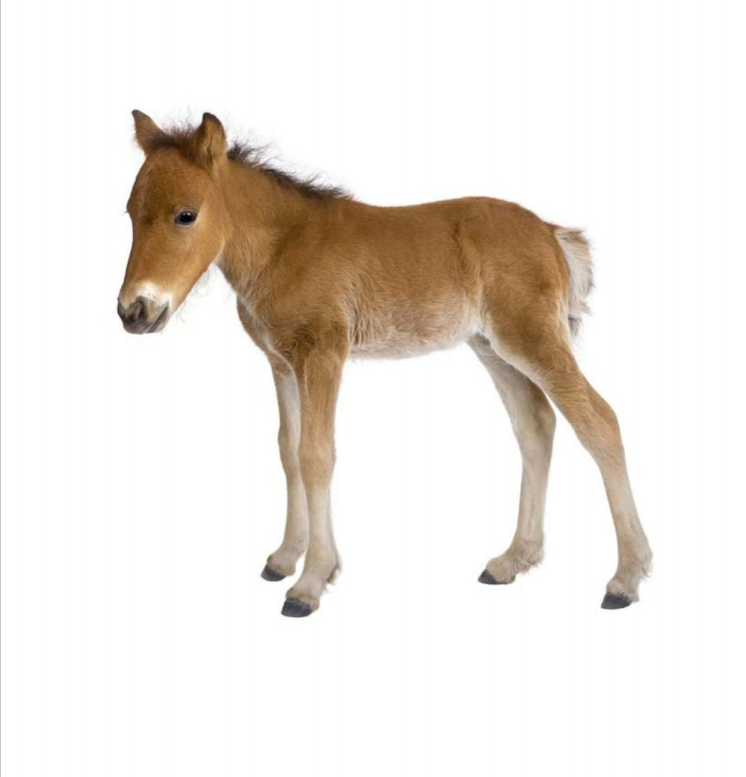
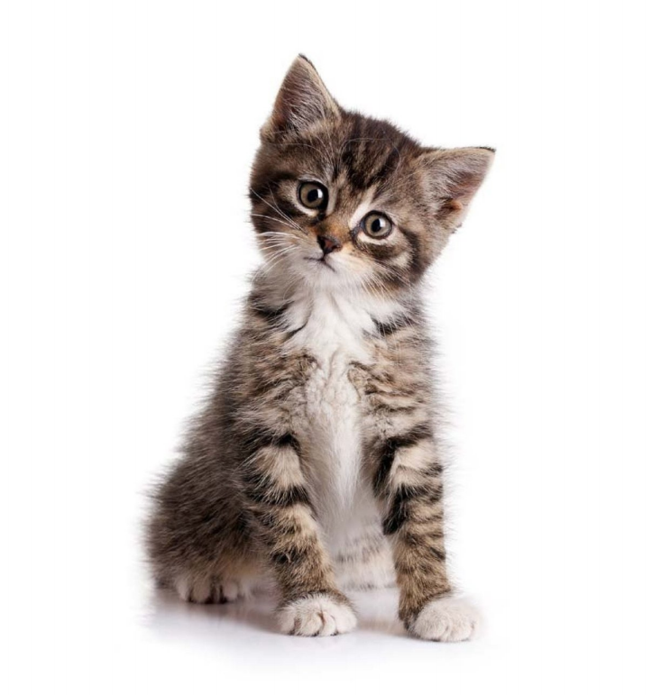
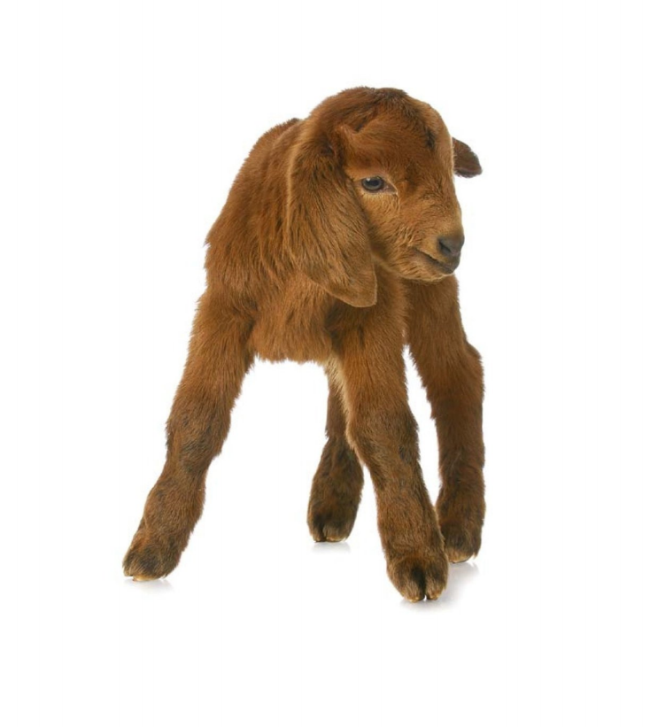
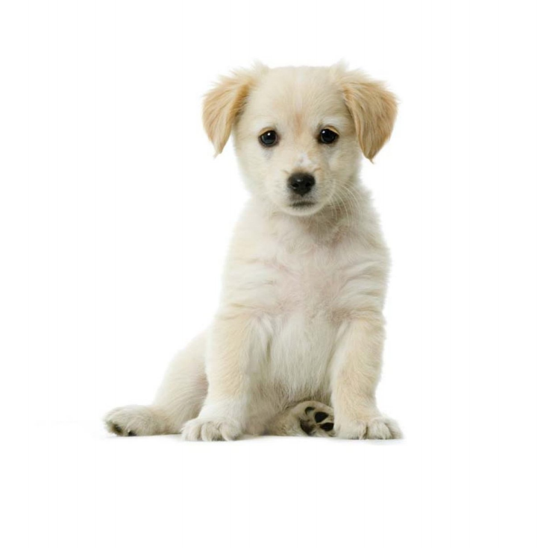
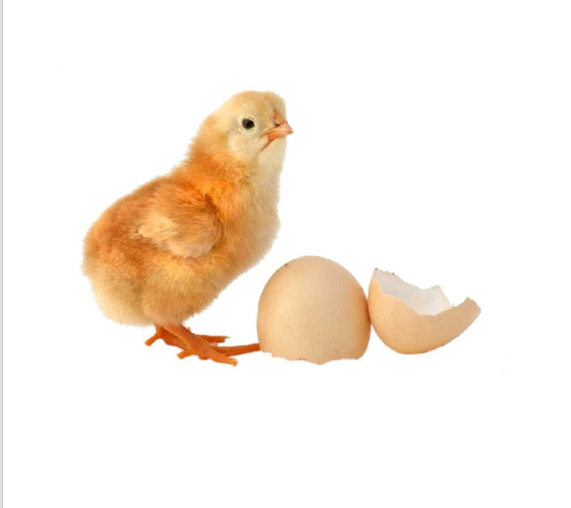
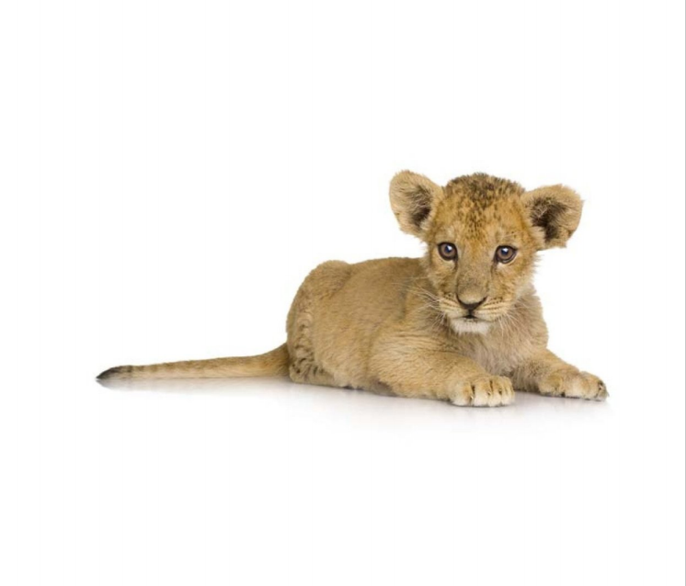
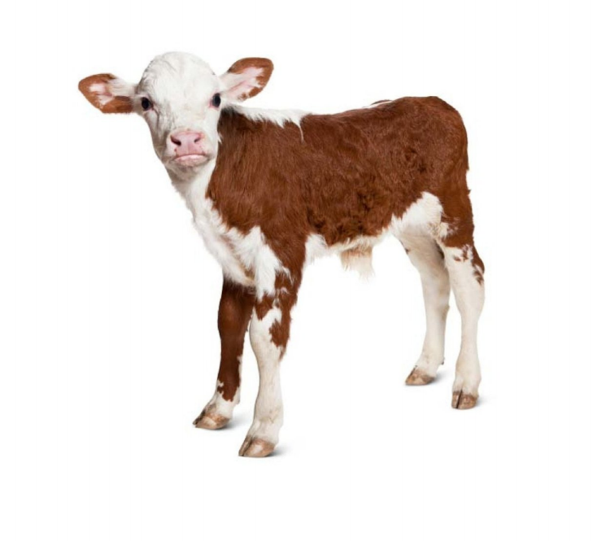
Do You know
These Baby Animals?

Slide 2
Click on the colored buttons to start getting to know them!

Slide 3
This is a puppy.

Slide 4
This is a chick.

Slide 5
This is a cub.

Slide 6
This is a calf.

Slide 7
This is a kid.

Slide 8
This is a foal.

Slide 9
This is a cat.

